Slide 1
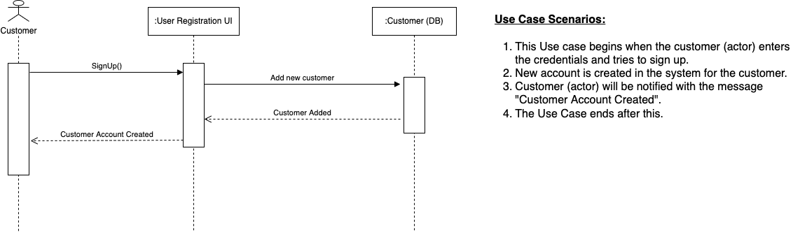
Flaunt Sequence Diagram – Team 02 01. Account Management Use Case : 01.01. Creating a user account

Slide 2
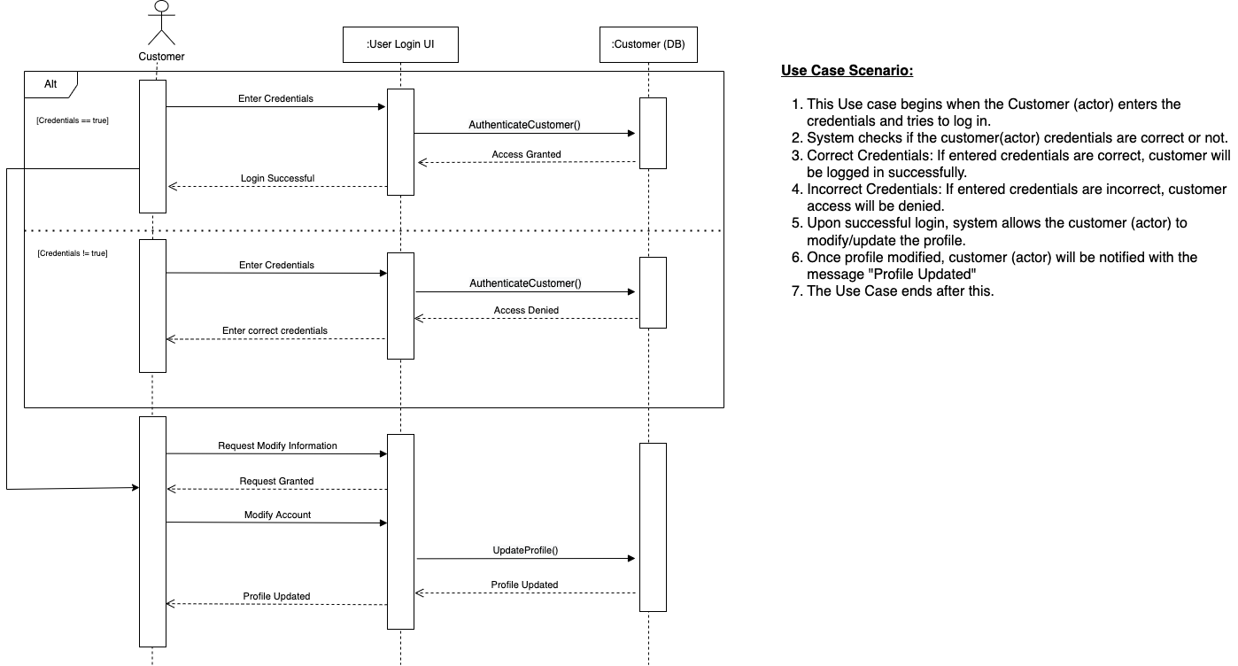
Flaunt Sequence Diagram – Team 02 01. Account Management Use Case : 01.02. Modify a user account detail

Slide 3
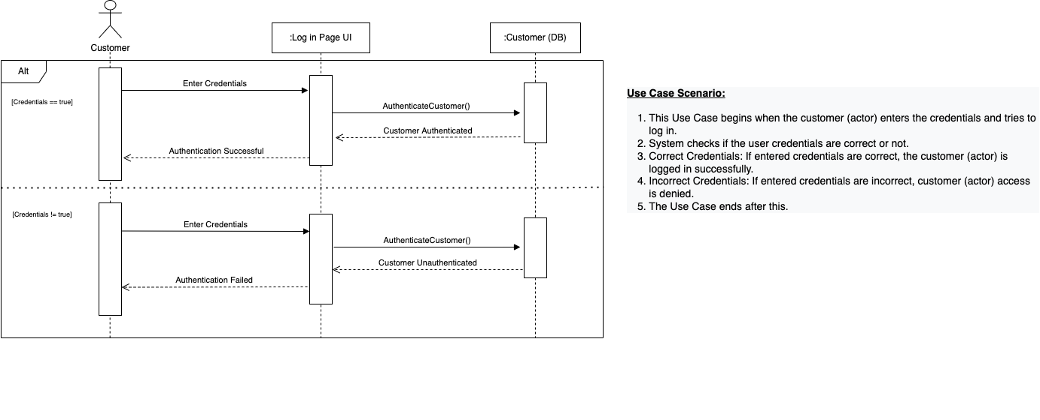
Flaunt Sequence Diagram – Team 02 01. Account Management Use Case : 01.03. User account authentication

Slide 4
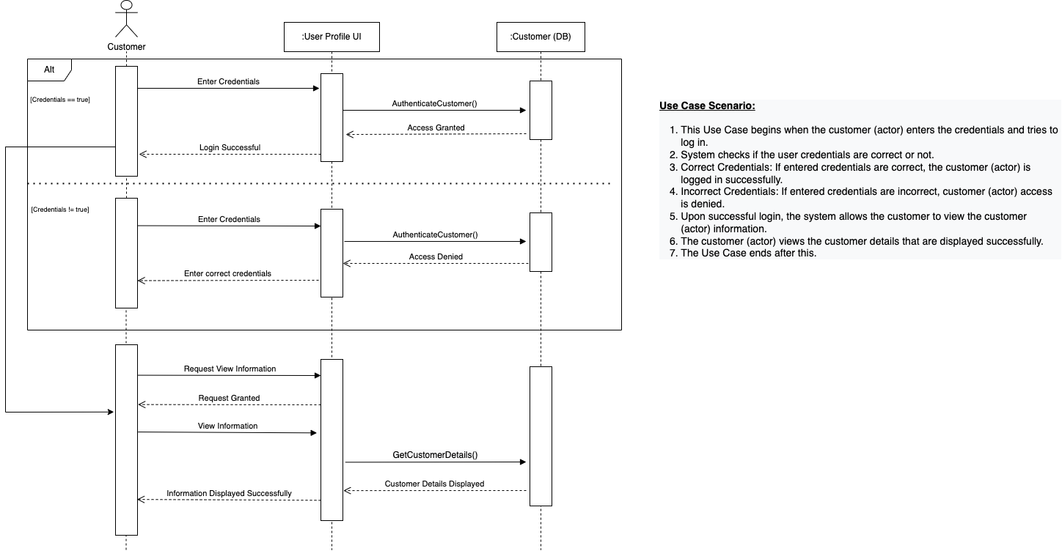
Flaunt Sequence Diagram – Team 02 01. Account Management Use Case : 01.04. View account information

Slide 5
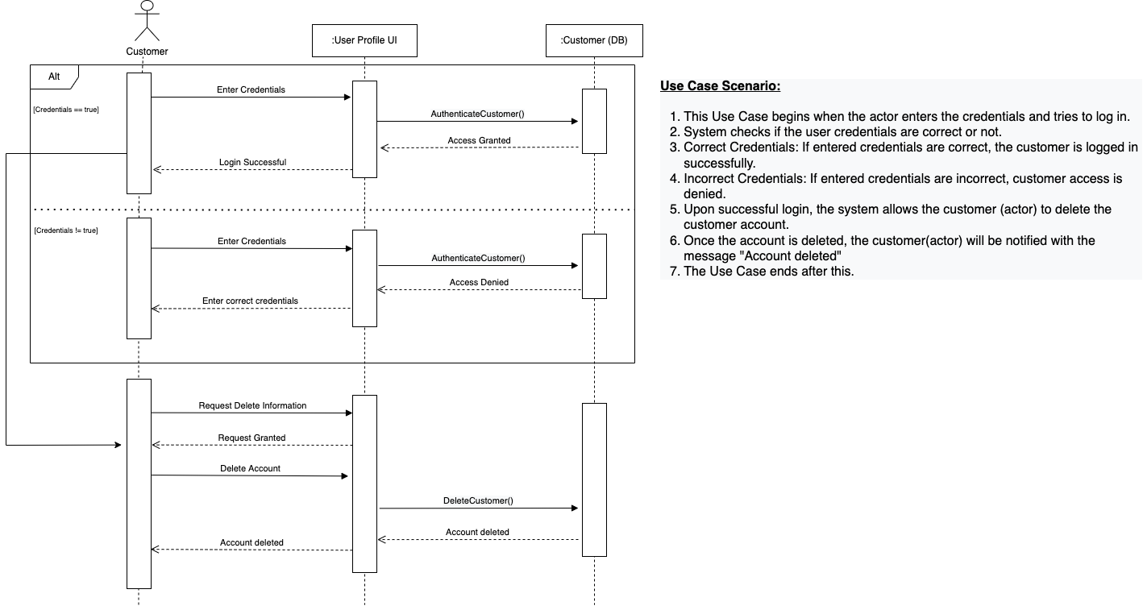
Flaunt Sequence Diagram – Team 02 01. Account Management Use Case : 01.05. Deleting a user account

Slide 6
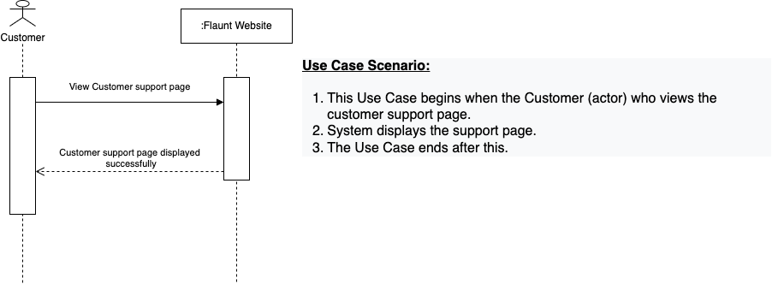
Flaunt Sequence Diagram – Team 02 01. Account Management Use Case : 01.06. Utilizing customer support (FAQs & Email only)

